Slide 1
HIV/AIDS Epidemiology In Area 4, 2022
Jisell Guadamuz
HIV/AIDS Program Coordinator
Florida Department of Health
Data as of 6/30/2023

Slide 2
Baker, Clay, Duval, Nassau and St. Johns Counties
(Excluding Department of Corrections)
Data as of 6/30/2023

Slide 3
Acronyms
HIV: Human Immunodeficiency Virus
AIDS: Acquired Immune Deficiency Syndrome
IDU: Injection Drug Use
MMSC: Male-to-Male Sexual Contact
MSM: Men Who Have Sex with Men

Slide 4
Acronyms, continued
IDU: Injection Drug Use
MMSC: Male-to-Male Sexual Contact
MMSC/IDU: Male-to-male sexual contact and injection drug use.
MSM: Men Who Have Sex with Men
nPEP: Non-Occupational Post-Exposure Prophylaxis
PEP: Post-Exposure Prophylaxis
PrEP: Pre-Exposure Prophylaxis

Slide 5
Acronyms, Continued
PWH: Persons with HIV
PWID: Persons Who Inject Drugs
STI: Sexually Transmitted Infection
VL: Viral Load

Slide 6
Technical Notes
Data for 2020 and 2021 should be interpreted with caution due to the impact of a public health emergency on HIV testing, care-related services and case surveillance activities in state and local jurisdictions.
Unless otherwise noted, all data in this presentation are as of 6/30/2023.

Slide 7
Technical Notes, continued
Each year, the HIV data for the previous calendar year and all prior years back to 1979 are finalized and frozen for reporting purposes on June 30. The frozen data are used in all data reports until the following June 30, when the continuously deduplicated HIV/AIDS data set will be finalized and frozen again.
Unless otherwise noted, population-related data (such as rates) are provided by FLHealthCHARTS as of 6/30/2023.

Slide 8
Technical Notes, continued
HIV-related deaths represent persons with an HIV diagnosis in the CDC’s enhanced HIV/AIDS Reporting System (eHARS) who resided in Florida at death and whose underlying cause of death was HIV, regardless of whether their HIV status was reported in Florida.
STI data are derived from the Surveillance Tools and Reporting System (STARS) and provided by the STD Prevention and Control Section as of 7/01/2023.

Slide 9
Technical Notes, continued
HIV diagnoses by year represent persons whose HIV was diagnosed in that year, regardless of AIDS status at time of diagnosis.
AIDS and HIV diagnoses by year are not mutually exclusive and cannot be added together.

Slide 10
Technical Notes, continued
HIV prevalence data represent PWH living in Florida through the end of the calendar year, regardless of where they were diagnosed.
For diagnosis data over time, sub-geographical area data exclude Florida Department of Corrections (FDC) and Federal Correctional Institution (FCI) diagnoses. For prevalence data, area and county data include FDC and FCI data.

Slide 11
Technical Notes, continued
Adult diagnoses represent people ages 13 years and older; pediatric diagnoses represent people under the age of 13 years.
    For data by year of diagnosis, age is by age at diagnosis.
    For prevalence data, age is by current age at the end of the most recent calendar year, regardless of age at diagnosis.

Slide 12
Technical Notes, continued
Unless noted, White and Black people are non-Hispanic/Latino, and Other (which may be omitted in some graphs due to small numbers) represents American Indian/Alaska Native, Asian/Pacific Islander, or multi-racial.

Slide 13
Definitions of Mode of Exposure Categories
Heterosexual: Sexual contact between a male and female who received an HIV diagnosis or had a known HIV risk.
Other Sexual Contact: Other sexual contact resulting in a person acquiring HIV.
Other Risk: Includes recipients of clotting factor for hemophilia or other coagulation disorders, recipients of HIV-infected blood or blood components other than clotting factor or of HIV-infected tissue, perinatal and other pediatric risks, or other confirmed risks.

Slide 14
Florida’s Four Key Components Plan
To Eliminate HIV Transmission and Reduce HIV-Related Deaths
Implement routine HIV and STI screening in health care settings and priority testing in non-health care settings.
Provide rapid access to treatment and ensure retention in care (Test and Treat).

Slide 15
Florida’s Four Key Components Plan To Eliminate HIV Transmission and Reduce HIV-Related Deaths, Continued
Improve and promote access to antiretroviral PrEP and nPEP.
Increase HIV awareness and community response through outreach, engagement, and messaging.

Slide 16
Demographics of People
Diagnosed with HIV

Slide 17
Diagnoses of HIV, 2013–2022, Area 4

Slide 18
Diagnoses of AIDS, 2013–2022, Area 4

Slide 19
Adult HIV Diagnosis Rates by Sex at Birth, 2013–2022, Area 4
Male to Female
Ratio
2013 = 2.5 to 1
2022 = 3.8 to 1

Slide 20
Adult AIDS Diagnosis Rates by Sex at Birth, 2013–2022, Area 4
Male to Female
Ratio
2013 = 2.4 to 1
2022 = 2.6 to 1

Slide 21
Adult HIV and AIDS Diagnoses
By Sex at Birth, 2022, Area 4
HIV
N=334
AIDS
N=156

Slide 22
Adult HIV Diagnosis Rates
By Race or Ethnicity, 2013–2022, Area 4

Slide 23
Adult Male HIV Diagnosis Rates
By Race or Ethnicity, 2013–2022, Area 4

Slide 24
Adult Female HIV Diagnosis Rates
By Race or Ethnicity, 2013–2022, Area 4

Slide 25
Adult HIV Diagnoses by Age
At Diagnosis, 2013–2022, Area 4

Slide 26
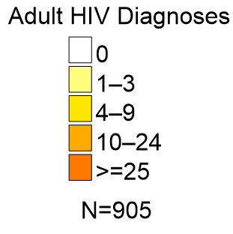
Adult HIV Diagnoses by ZIP Code of Residence at Diagnosis, 2019–2022, Area 4
County map boundaries include agricultural and/or conservation areas, which may not be populated.

Slide 27
Adult HIV and AIDS Diagnoses and Population by Race or Ethnicity, 2022, Area 4
Area 4 Adult
Population Estimate
N=1,420,832
HIV
N=334
AIDS
N=156

Slide 28
Adult HIV Diagnosis Rates by Sex
And Race or Ethnicity, 2022, Area 4
Rate Ratios
Males
Black to White: 7.2 to 1
Hispanic/Latino to White: 4.1 to 1
Females
Black to White: 7.5 to 1
Hispanic/Latina to White: 4.3 to 1

Slide 29
Adult HIV Diagnoses By Sex and Age at Diagnosis,
2022, Area 4

Slide 30
Adult Male HIV Diagnoses by Mode of
Exposure, 2013–2022, Area 4

Slide 31
Adult Female HIV Diagnoses by Mode of
Exposure, 2013–2022, Area 4

Slide 32
HIV Co-morbidity Data

Slide 33
PWH with a Co-occurring Diagnosis of an STI by Type and Year of STI Report, 2018–2022, Area 4
Year of STI Report | HIV/ Early Syphilis¹ | HIV/ Chlamydia | HIV/ Gonorrhea
2018 | 201 | 185 | 268
2019 | 229 | 222 | 352
2020 | 207 | 193 | 269
2021 | 283 | 289 | 334
2022 | 280 | 263 | 321
Percentage Change | 39% | 42% | 20%
¹Primary, secondary and early non-primary, non-secondary syphilis.

Slide 34
HIV Prevalence in Area 4

Slide 35
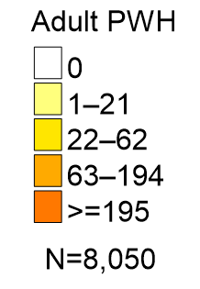
Adult PWH by ZIP Code of Residence,¹ 2022
Living in Area 4
¹Excludes homeless persons and persons with unknown ZIP codes.

Slide 36
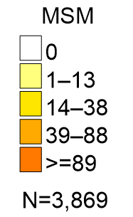
MSM¹ with HIV by ZIP Code of Residence,² 2022
Living in Area 4
¹Data includes MSM/PWID.
²Excludes homeless persons and persons with unknown ZIP codes.

Slide 37
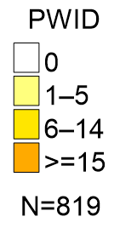
PWID¹ with HIV by ZIP Code of Residence,² 2022
Living in Area 4
¹Data includes MSM/PWID.
²Excludes homeless persons and persons with unknown ZIP codes.

Slide 38
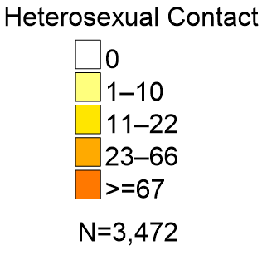
Persons with Heterosexual Contact with HIV by ZIP Code of Residence,¹ 2022, Living in Area 4
¹Excludes homeless persons and persons with unknown ZIP codes.

Slide 39
Adults with HIV, 2022, Living in Area 4
 |  | Male # | % | Female # | % | Total # | %
Race/ Ethnicity | White | 1,670 | 20% | 431 | 5% | 2,101 | 26%
 | Black | 3,155 | 39% | 1,902 | 23% | 5,057 | 62%
 | Hispanic/Latino | 492 | 6% | 163 | 2% | 655 | 8%
 | Other | 182 | 2% | 72 | <1% | 254 | 3%
Age Group | 13-19 | 21 | <1% | 17 | <1% | 38 | <1%
 | 20-29 | 601 | 7% | 117 | 1% | 718 | 8%
 | 30-39 | 1,259 | 15% | 423 | 5% | 1,682 | 20%
 | 40-49 | 997 | 12% | 681 | 8% | 1,678 | 20%
 | 50+ | 2,621 | 32% | 1,330 | 16% | 3,951 | 49%
Mode of Exposure | MMSC | 3,608 | 44% | 0 | <1% | 3,608 | 44%
 | IDU | 273 | 3% | 279 | 3% | 552 | 6%
 | MMSC/IDU | 269 | 3% | 0 | <1% | 269 | 3%
 | Heterosexual Contact | 1,247 | 15% | 2,231 | 27% | 3,479 | 43%
 | Other Sexual Contact | 43 | <1% | 2 | <1% | 45 | <1%
 | Other risk | 58 | <1% | 56 | <1% | 114 | 1%
Total | Total | 5,499 | 68% | 2,568 | 31% | 8,067 | 100%
Rounding may cause percentages to total more or less than 100.

Slide 40
HIV Care Continuum in Area 4

Slide 41
HIV Care Continuum Definitions
PWH: Persons with HIV living in Florida at the end of 2022.
In Care: PWH with at least one documented VL or CD4 lab, medical visit or prescription from 1/1/2022 through 3/31/2023.
Retained in Care: PWH with two or more documented VL or CD4 labs, medical visits or prescriptions at least three months apart from 1/1/2022 through 6/30/2023.

Slide 42
HIV Care Continuum Definitions, continued
Suppressed Viral Load: PWH with a suppressed VL (<200 copies/mL) on their last VL lab from 1/1/2022 through 3/31/2023.
Not in Care: PWH with no documented VL or CD4 lab, medical visit or prescription from 1/1/2022 through 3/31/2023.
Linked to Care: PWH with at least one documented VL or CD4 lab, medical visit or prescription following their first HIV diagnosis date.

Slide 43
Persons Who Received an HIV Diagnosis Along the
HIV Care Continuum in 2022, Area 4

Slide 44
PWH Along the HIV Care Continuum in 2022,
Living in Area 4
Note: 86% of persons retained in care had a suppressed viral load.

Slide 45
PWH Along the HIV Care Continuum, 2020–2022,
Living in Area 4

Slide 46
PWH by Race or Ethnicity Along the HIV Care Continuum
In 2022, Living in Area 4

Slide 47
PWH Along the HIV Care Continuum in 2022,
Living in Florida Compared to Area 4

Slide 48
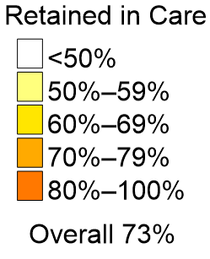
Percentage of PWH Who Were Retained in Care by ZIP Code of Residence¹ in 2022, Living in Area 4
¹Excludes data from homeless persons and persons with unknown ZIP codes.

Slide 49
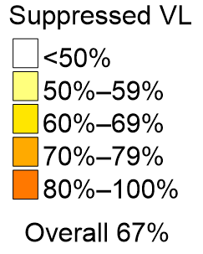
Percentage of PWH Who Had a Suppressed VL by ZIP Code of Residence,¹ 2022, Living in Area 4
¹Excludes data from homeless persons and persons with unknown ZIP codes.

Slide 50
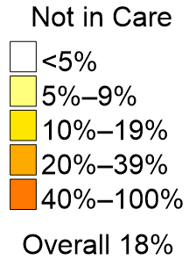
Percentage of PWH Who Were Not in Care by ZIP Code of Residence¹ in 2022, Living in Area 4
¹Excludes data from homeless persons and persons with unknown ZIP codes.

Slide 51
HIV-Related Deaths in Area 4

Slide 52
Rate of HIV-Related Deaths
2013–2022, Area 4

Slide 53
HIV Prevention for Area 4

Slide 54
Priority Populations for
Primary HIV Prevention
  These data were calculated from HIV diagnoses 2020–2022 and represent the proportion of each race or mode of exposure group to the total diagnoses.
  These data are used to identify and prioritize testing, PrEP and other HIV prevention services to those at greatest risk for acquiring HIV in Florida.

Slide 55
Priority Populations for Primary HIV
Prevention in 2022, Area 4
MSM=MMSC and MMSC/IDU diagnoses, and PWID=IDU and MMSC/IDU diagnoses;
thus, the data are not mutually exclusive. Data is for HIV diagnoses 2020–2022.
Rounding may cause percentages to total more or less than 100.

Slide 56
Priority Prevention
Populations for PWH
  These data were calculated from PWH living in Florida at year-end 2022 and represent the proportion of each race or mode of exposure group to the total PWH.
  These data are used to prevent further transmission of HIV for those already diagnosed with HIV by providing linkage to care and other services to improve health outcomes and viral suppression to those who need it.

Slide 57
Priority Prevention Populations for PWH in 2022, Living in Area 4
MSM=MMSC and MMSC/IDU diagnoses, and PWID=IDU and MMSC/IDU diagnoses;
thus, the data are not mutually exclusive.
Rounding may cause percentages to total more or less than 100.

Slide 58
HIV Testing
PrEP
Everyone between the ages of 13 and 64 should get tested for HIV at least once. Persons at increased risk for HIV should get tested at least annually. Visit knowyourhivstatus.com for testing options in your area or to order a free at-home testing kit.
Florida law (section 384.31, Florida Statutes) requires all pregnant women to be tested for HIV and other STIs at their initial prenatal care visit, again at 28–32 weeks and at labor and delivery if their HIV status is unknown.
PrEP medication, taken as directed, can reduce the risk of acquiring HIV through sexual contact by over 90% and through injection drug use by 70%. Condoms are still important during sex to prevent other STIs and unwanted pregnancy. STIs are increasing in Florida and can increase HIV risk. To find a PrEP provider who can help you decide if PrEP is right for you, visit preplocator.org.
Antiretroviral Therapy (ART)
Florida HIV/AIDS Hotline
For PWH, starting ART as soon as possible improves health outcomes and quality of life by reducing viral load and the risk of disease progression. People living with HIV who take antiretroviral medication as prescribed and achieve and maintain an undetectable viral load cannot transmit HIV to their sexual partners. ART is recommended for all PWH, regardless of how long they have had HIV or how well they feel. To find a care provider or to learn more about the resources available to PWH, visit floridaaids.org.
1-800-352-2437 English
1-800-545-7432 Spanish
1-800-243-7101 Haitian Creole
1-888-503-7118 Hearing/Speech Impaired
211bigbend.org/flhivaidshotline
Text FLHIV or flhiv to 898211
For more information, email
DiseaseControl@flhealth.gov

Slide 59
Some Useful Links
Department of Health HIV/AIDS Section
floridaaids.org
Department of Health, FLHeathCHARTS
FLHealthCHARTS.gov: Home
Ending the HIV Epidemic (EHE) Dashboard
https://www.flhealthcharts.gov/EHE/rdPage.aspx?rdReport=Overview
CDC HIV Surveillance Reports (State and Metro Data)
cdc.gov/hiv/library/reports/hiv-surveillance.html
CDC’s Morbidity and Mortality Weekly Report (Special Articles on Diseases, Including HIV)
cdc.gov/mmwr
U.S. Census Data (Available by State and County)
census.gov
World Health Organization: who.int/data/gho/data/themes/hiv-aids

Slide 60
Florida HIV/AIDS Surveillance Data Area 4 Contact
Chandrea Carter
Florida Department of Health in
Duval County
Phone: 904-253-2954
Email: Chandrea.Carter@flheatlh.gov
HIV/AIDS surveillance data are frozen on June 30 for the previous calendar year.
These are the same data used for FLHealth CHARTS and all grant-related data.
flhealthcharts.com/charts/CommunicableDiseases/default.aspx
To protect, promote and improve the health of all people in Florida through integrated state, county and community efforts.

Slide 61
Thank you!

